Slide 1


Alliance for the Advancement of End of Life Care
2021 Legislative Update
Louisiana & Mississippi

Slide 2
2021
Legislative Update
Alliance for the
Advancement of End of Life Care
Table of Contents
Who We Are
#01
Louisiana Update
#02
Mississippi Update
#03
What's Next
#04

Slide 3

2021
Legislative Update
Alliance for the
Advancement of End of Life Care
Who We Are

Slide 4
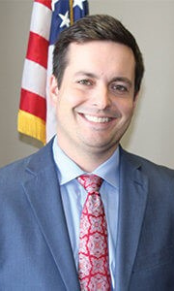

2021
Legislative Update
Alliance for the
Advancement of End of Life Care
Meet Our Team
John Morgan Hughes
Elizabeth Harper

Slide 5



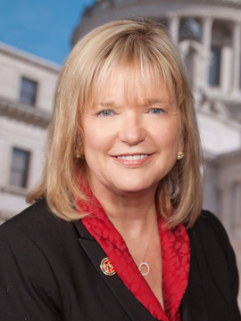


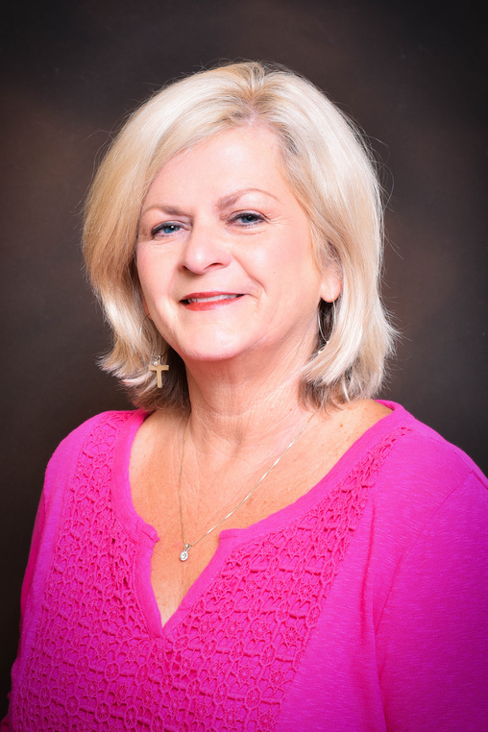

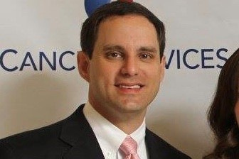
Chad Blalack
Jeremy Bolling
LaNette Brown
Becky
Curry
Carla
Davis
Tonya
Hall
Becky Pardue
Christa Puckett
Jon
Rills

Slide 6

2021
Legislative Update
What We Do
Amplify your voice at the Louisiana and Mississippi State Capitols

Slide 7

How We Do It
  Cultivate relationships with government leaders
  Stay updated on rules, regulations, laws and executive orders
  Attend legislative committees, task forces and advisory councils

Slide 8

2021
Legislative Update
Alliance for the
Advancement of End of Life Care
Mississippi
Legislative Update

Slide 9

HB 294 by Representative Currie
TO DELETE THE REPEALER ON THE SECTION THAT AUTHORIZES
MEDICAL DIRECTORS OF HOSPICES TO PRESCRIBE CONTROLLED
SUBSTANCES FOR PATIENTS OF THE HOSPICE FOR TERMINAL
DISEASE PAIN WITHOUT HAVING AN IN-PERSON FACE-TO-FACE
VISIT WITH A PATIENT.
Bill History: 03-22-21 G Signed by the Governor
Legislation

Slide 10
HB 296 by Representative Currie (Combined w/ 294)
TO AUTHORIZE THE STATE DEPARTMENT OF HEALTH TO ISSUE
UP TO TWO NEW PEDIATRIC PALLIATIVE CARE HOSPICE
LICENSES DURING A CERTAIN PERIOD OF TIME.
Bill History: 02-16-21 S and also referred to committee on Senate
Accountability and Transparency
Legislation

Slide 11
HB 1174 by Representative Currie
AN ACT TO AUTHORIZE THE DEPARTMENT OF CORRECTIONS TO
PROVIDE FOR HOSPICE CARE SERVICES FOR INMATES WHO ARE
CONFINED IN FACILITIES UNDER THE JURISDICTION OF THE
DEPARTMENT AND WHO ARE TERMINALLY ILL.
Bill History: 03-24-21 S Senate conferees named - Barnett, Wiggins,
Legislation

Slide 12

2021
Legislative Update
Alliance for the
Advancement of End of Life Care
Louisiana
Legislative Update

Slide 13
HB 146 by Representative Hilferty
Establishes a $2000 income tax credit following the delivery of a stillborn child
06-29-21 Signed by the Governor
Effective 01-01-22
Legislation
HB 197 by Representative C. Owen
Creates "Licensure For Healthcare Dependents"
Allows for transfer of licensures for dependents of healthcare professionals who relocate to Louisiana
06-15-21 Signed by the Governor
Effective 08-01-21

Slide 14
HB 270 by Representative Magee
Updates the definitions and exemptions to telemedicine and telehealth
06-14-21 Signed by the Governor
Effective 08-01-21
Legislation
HR 51 by Representative Duplessis
Request the Department of Public Safety and Corrections and the Louisiana
Department of Health, to create a commission to study compassionate release, medical furlough and medical parole requirements
06-03-21 Presented to the Secretary of State

Slide 15
SB 155 by Senator Bouie
Updates the Louisiana Social Work Practice Act
Board of Social Work Examiners Requirements
Qualifications of Licenced Clinial Social Worker
Out of State Social Workers
Licensure Renewals
Disciplinary Actions
06-11-21 Signed by the Governor
Effective 01-01-22
Legislation

Slide 16
HB 356 by Representative Bacala
Requires regular evaluation of and reporting on Medicaid administration and services
Failed
Legislation
HB 426 by Representative Amedee
Relative to visitation of nursing homes residents and assisted living residents
HB 442 by Representative Bagley
Relative to licensed profession of physician assistant

Slide 17
HB 485 by Representative Zeringue
Established the Medicaid Managed Care Authority as a policy making and oversight body
SB 137 by Senator Talbot
Failed
Legislation
Provides for Medicaid managed care for long-term supports and services
HB 495 by Representative Ivey
Allows full practice authority for advanced practice registered nurses
HB 442 by Representative Bagley
Relative to licensed profession of physician assistant

Slide 18
2021
Legislative Update
Alliance for the
Advancement of End of Life Care
Ongoing
Issues/Projects

Slide 19
Get members appointed to state boards and advisory councils
1
LA Palliative Care Advisory Council renewal
2
What's
Next
Continue MS moratorium and LA facility needs review
3
Ensure hospice is represented in the medical marijuana program during the 2022 MS Session
4

Slide 20

2021
Legislative Update
Alliance for the
Advancement of End of Life Care
How Can You Help?

Slide 21
Get Involved
Get involved with your delegation, meet and greets and the alliance
Reach Out
Reach out to your legislators
Contact Us
Donate
Contact us with any regulatory issues.
Donate to your legislators and to the Alliance

Slide 22

2021
Legislative Update
Alliance for the
Advancement of End Life Care
John Morgan Hughes
601-672-4988
johnmorgan@jmhughesgroup.com
Elizabeth Duncan Harper
225-287-4020
elizabeth@allianceforhospice.org

